Slide 1
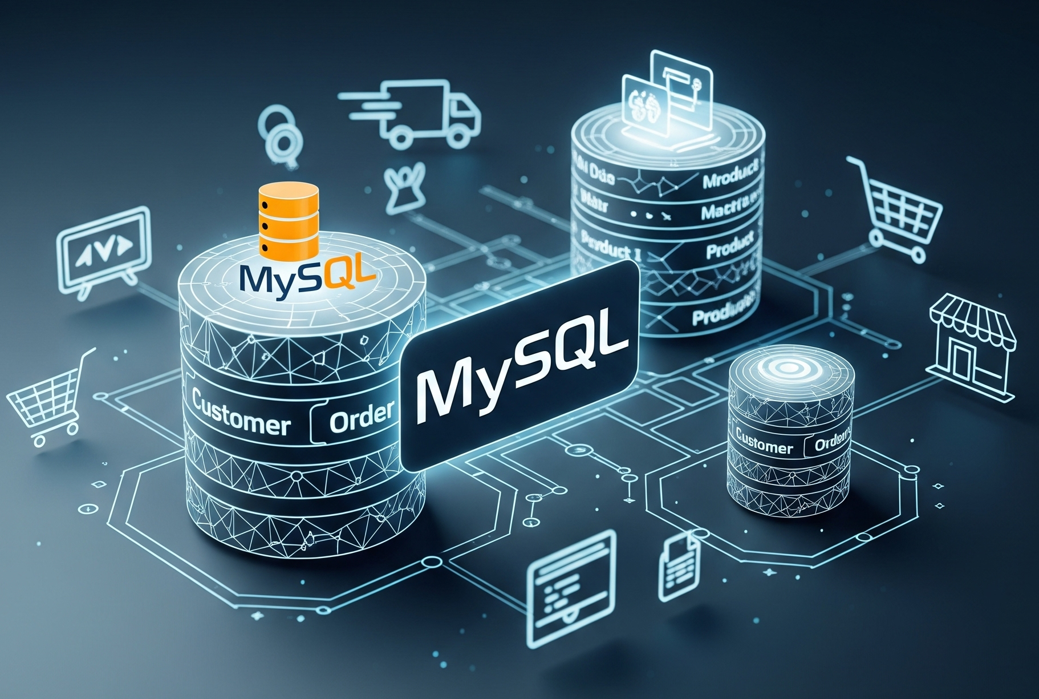
MySQL Database Design & Demonstration
Online Retail Management System
Prepared by
Avik Sarkhel

Slide 2
CONTENTS (Note: All content titles in this presentation are hyperlinked for direct navigation to their respective sections. Simply click on the content name to jump to it.)
01
02
03
04
05
06
About MySQL
Project Overview
Database Tables
A short Overview
SQL-Based Retail Model
Core Tables Overview
Entity Relationship Diagram
SQL Query Demonstrations
Conclusion & Learnings
Database schema visual representation
Practical data retrieval examples
Project takeaways and future analysis.

Slide 3
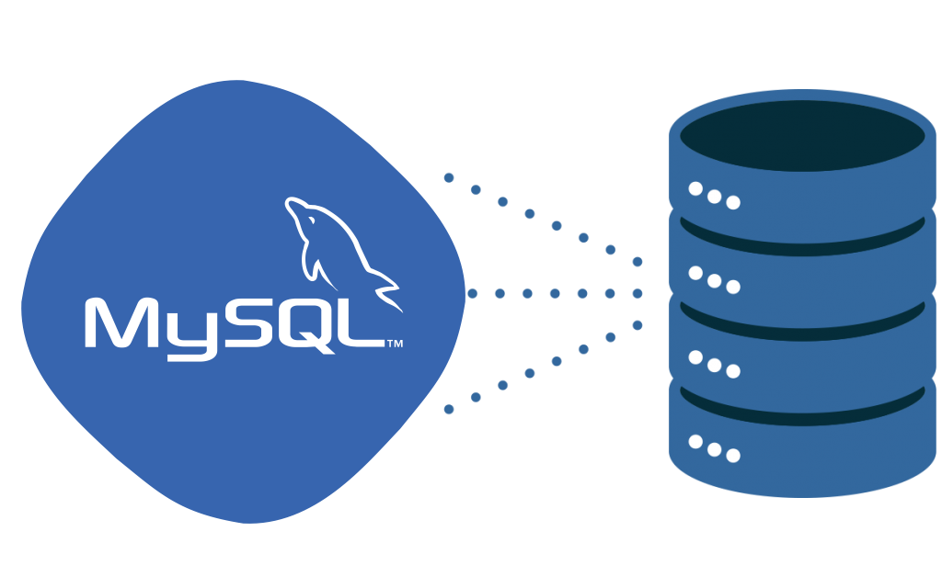
01
About MySQL
A short Overview

Slide 4

MySQL: The Backbone of Modern Applications
CONTENTS
MySQL is an open-source relational database management system (RDBMS) that uses SQL (Structured Query Language) to access and manage data. It is widely adopted across industries for powering web applications, data analytics platforms, ERP systems, and cloud-based solutions. Known for its speed, reliability, and scalability, MySQL ensures data integrity through features like ACID compliance and foreign key constraints, making it a trusted choice for building robust, production-ready systems.
Why MySQL Was Used in This Project:
MySQL was chosen for this project due to its widespread industry adoption, simplicity, and powerful capabilities for managing structured data. As a proven relational database system, it offers strong support for data normalization, integrity constraints, and scalable query execution. Its compatibility with real-world applications makes it ideal for demonstrating key concepts such as data modeling, relational design, and SQL-based analytics. The project leverages MySQL to simulate a practical retail environment, showcasing how businesses use databases to manage transactions, customers, and operations efficiently.

Slide 5

02
Project Overview
SQL-Based Retail Model

Slide 6


CONTENTS
This project involves the creation and demonstration of a fully functional MySQL relational database designed for an online retail management system. It includes seven interconnected tables that simulate a real-world retail environment, covering customers, products, orders, payments, and shipping.
The objective was to:
Design a normalized database schema with foreign key relationships
Populate each table with sample data
Demonstrate real-life SQL queries that generate valuable business insights
Highlight the power of MySQL for data modeling and analysis
This practical demonstration showcases how MySQL can be used to manage and analyze structured data in a business context.

Slide 7

03
Database Tables
Core Tables Overview

Slide 8
CONTENTS
This project includes seven normalized tables designed to represent different components of an online retail system:
Table Name | Description
customers | Stores customer information and sign-up data
categories | Defines product categories
products | Contains product details and stock info
orders | Records customer purchase transactions
order_items | Line items within each order
payments | Captures payment details per order
shipping | Tracks delivery info and status

Slide 9
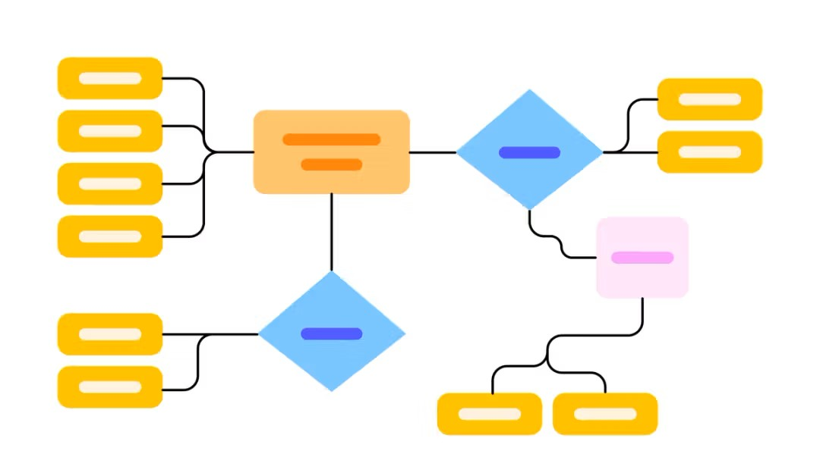
04
Entity Relationship Diagram
Database schema visual representation

Slide 10
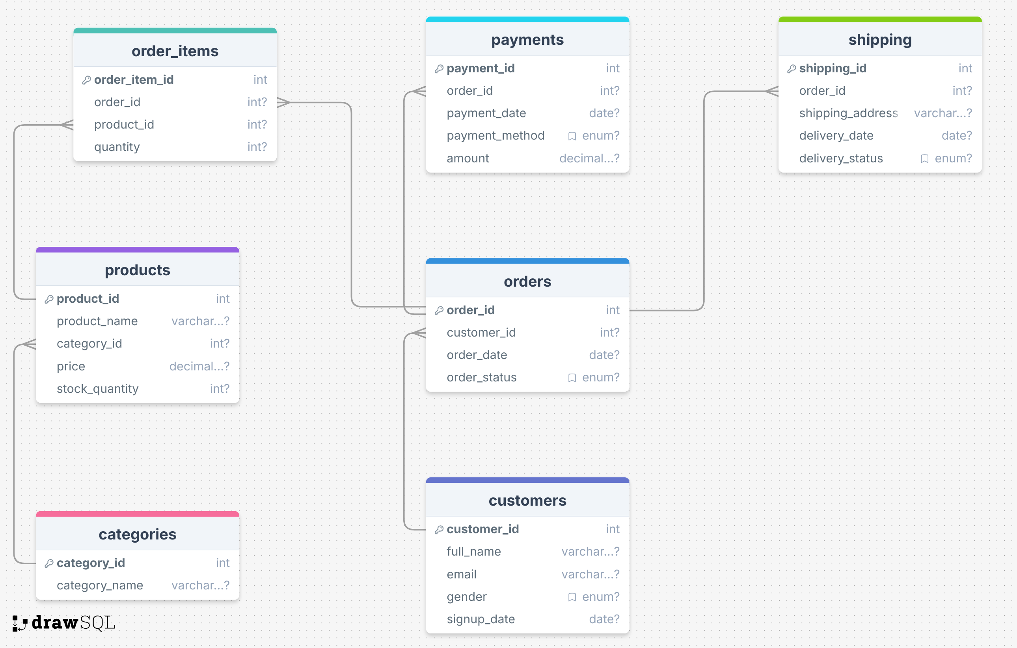
CONTENTS
This Entity-Relationship Diagram (ERD) visually maps the online_retail database, illustrating its tables (entities) like customers, products, and orders, and their interconnections. It clearly shows how data flows and relates, for example, how a customer places an order which contains various products via order_items, and how payments and shipping are linked to orders. It serves as a blueprint for the database structure.

Slide 11

05
SQL Query Demonstrations
Practical data retrieval examples

Slide 12
CONTENTS
This section showcases the practical application of MySQL through a series of queries designed to extract meaningful insights from the online_retail database. The demonstration highlights how to retrieve specific data, analyze sales trends, identify key customer behaviors, and monitor inventory and shipping statuses. These examples illustrate the power and flexibility of SQL in managing and querying relational databases for business intelligence.
SQL Queries:
(Note: All content titles in this presentation are hyperlinked for direct navigation to their respective sections. Simply click on the content name to jump to it.)
List all customers and their order details (order ID, order date, and status).
Which products are currently out of stock?
Get total sales amount per product (based on order_items × product price).
Which customer spent the most money in total?
List all orders with their shipping status and delivery address.
Show how many orders were placed for each product.
Get the most popular product category (by number of items sold).

Slide 13
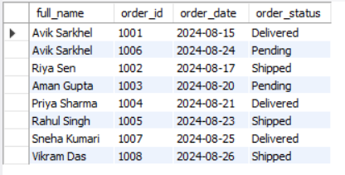
Queries
Query 1: Order Details by Customer
Purpose: To list all customers and their associated order details, including the order ID, order date, and the current status of each order.
SQL Code:
SELECT c.full_name, o.order_id, o.order_date, o.order_status
FROM customers c
JOIN orders o ON c.customer_id = o.customer_id;
Explanation: This query utilizes an INNER JOIN operation to combine records from the customers table (aliased as c) with records from the orders table (aliased as o). The join condition, c.customer_id = o.customer_id, establishes the link between customers and their respective orders through their shared customer ID. The selected columns retrieve the customer's full name and specific details for each order placed by that customer. This structure is fundamental for combining data from related tables.

Slide 14
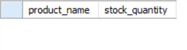
Queries
Query 2: Out of Stock Products
Purpose: To identify all products that currently have zero quantity in stock, indicating they are unavailable for purchase.
SQL Code:
SELECT product_name, stock_quantity
FROM products
WHERE stock_quantity = 0;
Explanation: This query directly selects the product_name and stock_quantity from the products table. The WHERE clause is then applied to filter these results, specifically retrieving only those products where the stock_quantity attribute is equal to 0. This concise query is essential for inventory management, allowing for quick identification of items that require replenishment.

Slide 15
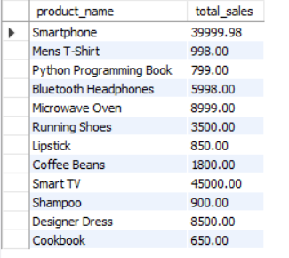
Queries
Query 3: Total Sales per Product
Purpose: To calculate the total revenue generated by each product, derived from the quantity sold through orders multiplied by the product's individual price.
SQL Code:
SELECT p.product_name, SUM(oi.quantity * p.price)
AS total_sales
FROM order_items oi
JOIN products p
ON oi.product_id = p.product_id
GROUP BY p.product_name;
Explanation: This query joins the order_items table (aliased as oi) with the products table (aliased as p) on their common product_id. It then calculates the total sales for each product by multiplying the quantity of each item sold by its price. The SUM() aggregate function is used to total these amounts for all instances of a particular product. Finally, GROUP BY p.product_name ensures that the sum is calculated individually for each distinct product, providing a clear overview of sales performance per item.

Slide 16
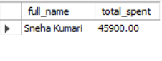
Queries
Query 4: Top-Spending Customer
Purpose: To identify the customer who has spent the highest total amount of money across all their orders.
SQL Code:
SELECT c.full_name, SUM(p.amount) AS total_spent
FROM customers c
JOIN orders o ON c.customer_id = o.customer_id
JOIN payments p ON o.order_id = p.order_id
GROUP BY c.full_name
ORDER BY total_spent
DESC
LIMIT 1;
Explanation: This query involves joining three tables: customers (aliased as c), orders (aliased as o), and payments (aliased as p). The joins link customers to their orders, and then orders to their respective payments. The SUM(p.amount) aggregate function calculates the total amount spent by each customer. Results are grouped by c.full_name to ensure a sum per customer. ORDER BY total_spent DESC sorts the customers from highest to lowest spending, and LIMIT 1 retrieves only the top customer, effectively identifying the highest spender.

Slide 17
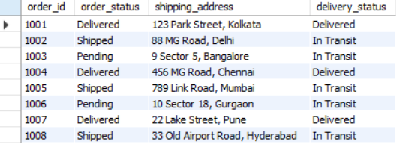
Queries
Query 5: Shipping Details
Purpose: To retrieve all orders along with their corresponding shipping status and the delivery address.
SQL Code:
SELECT o.order_id, o.order_status, s.shipping_address, s.delivery_status
FROM orders o
JOIN shipping s ON o.order_id = s.order_id;
Explanation: This query performs an INNER JOIN between the orders table (aliased as o) and the shipping table (aliased as s). The join condition o.order_id = s.order_id links each order to its specific shipping information. The selected columns include the order_id and order_status from the orders table, and the shipping_address and delivery_status from the shipping table, providing a complete view of an order's delivery journey.

Slide 18
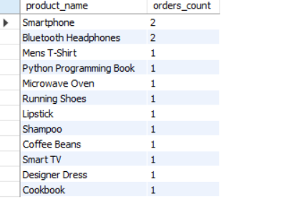
Queries
Query 6: Orders per Product
Purpose: To determine the total number of orders in which each product has been included.
SQL Code:
SELECT p.product_name, COUNT(oi.order_id) AS orders_count
FROM products p
JOIN order_items oi ON p.product_id = oi.product_id GROUP BY p.product_name;
Explanation: This query joins the products table (aliased as p) with the order_items table (aliased as oi) on their common product_id. The COUNT(oi.order_id) aggregate function counts the number of times each product_id appears in the order_items table, effectively counting how many orders each product is part of. The GROUP BY p.product_name clause ensures that the count is performed for each distinct product, providing an overview of product popularity by order frequency.

Slide 19
Queries
Query 7: Most Popular Category
Purpose: To identify the product category with the highest total number of items sold across all orders.
SQL Code:
SELECT c.category_name, SUM(oi.quantity) AS total_items_sold
FROM order_items oi
JOIN products p ON oi.product_id = p.product_id
JOIN categories c ON p.category_id = c.category_id
GROUP BY c.category_name
ORDER BY total_items_sold DESC
LIMIT 1;
Explanation: This query involves joining three tables: order_items (aliased as oi), products (aliased as p), and categories (aliased as c). The joins connect order items to their respective products, and then products to their categories. The SUM(oi.quantity) aggregate function calculates the total quantity of items sold for each category. Results are grouped by c.category_name. ORDER BY total_items_sold DESC sorts the categories by the total number of items sold in descending order, and LIMIT 1 retrieves only the top category, which represents the most popular one by sales volume.

Slide 20

05
Conclusion & Learnings
Project takeaways and future analysis.

Slide 21

CONTENTS
This MySQL demonstration showcased effective database management and querying for an online retail system. Key takeaways include:
Database Design: Structured schema ensures data integrity and efficient retrieval.
SQL Proficiency: Demonstrated query writing for diverse analytical needs.
Business Insights: Extracted critical information like sales, top customers, inventory, and popular categories.
Data Relationships: Understood complex relationships using junction tables.
Practical Application: Illustrated SQL's use in monitoring operational aspects.
The exercise highlights SQL's power in transforming data into actionable business intelligence.
Future Steps:
Data Extraction: Export datasets to Excel for further analysis.
Data Visualization: Use Power BI for interactive dashboards and deeper insights.

Slide 22


CONTENTS
Resources Used
MySQL Workbench (for database management and querying)
Microsoft PowerPoint (for presentation creation)
DrawSQL (for Entity Relationship Diagram generation)
Slidesgo (for presentation template)
Flaticon (for icons and stickers)
ChatGPT (for enhancing content)

Slide 23


Do you have any questions?
avik305sarkhel@gmail.com
Github Repository Link:
Click here

